Slide 1
Project 4 Firewall and IDS Configuration
By: Jacob Nava

Slide 2
Executive Summary
Based upon my previous work with my client, they have asked me to improve the security of their network. They specifically wish to implement a way to identify and log attacks against their web and production servers
After some research, I decided that installing an IDS/IPS would meet their needs and also determined that new rules would need to be configured on the firewall

Slide 3
Tasks Performed
Download and install Snort on the pfSense firewall
Configured Snort to log suspicious activity on the Untrusted and DMZ interfaces
Configured Snort to alert to some of the types of exploits I performed in the past on their network
Created firewall rules to block FTP traffic from the Untrusted network to the DMZ

Slide 4
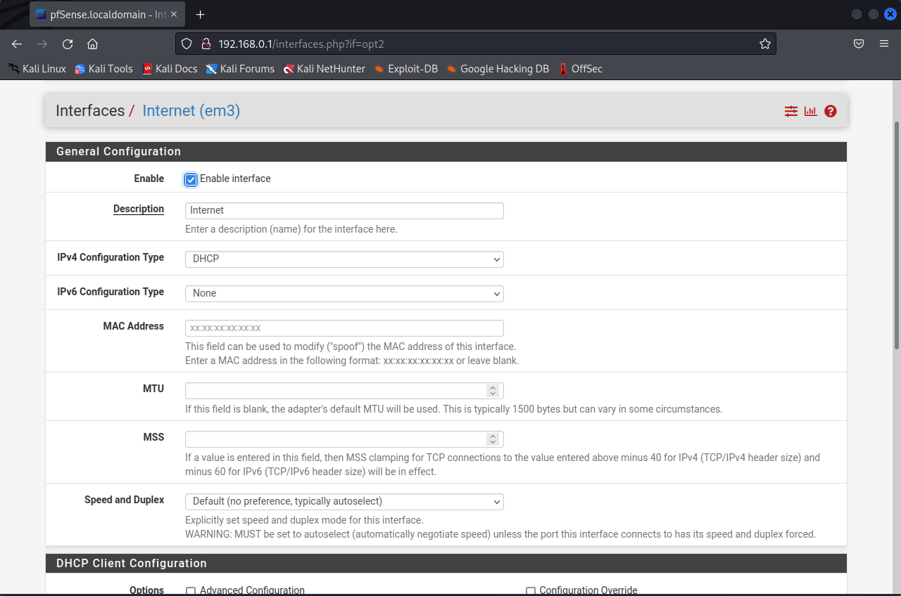
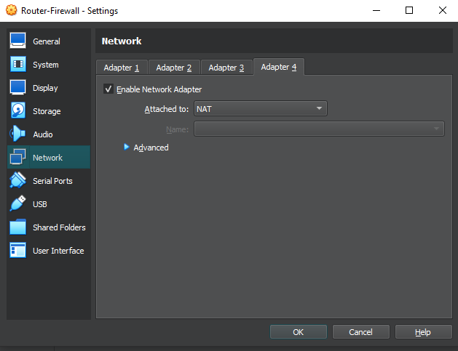
Enabling of Network Adapter 4
Enabled Network Adapter 4 to access the internet
Added Internet interface and configured

Slide 5
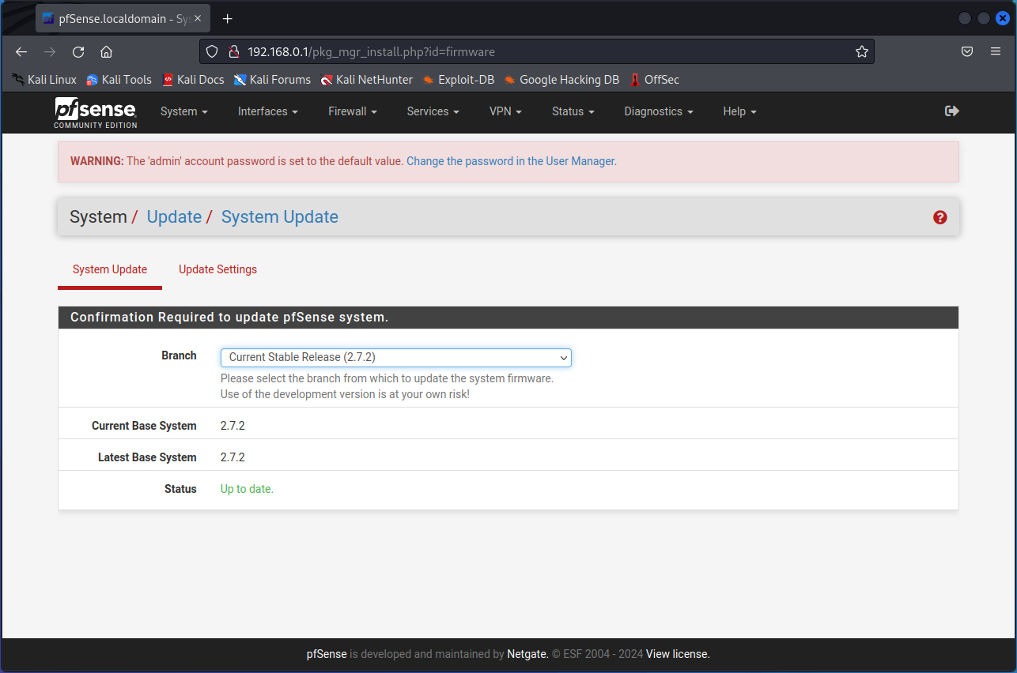
Updated pfSense
Updated pfSense to the latest version through the system update tab

Slide 6
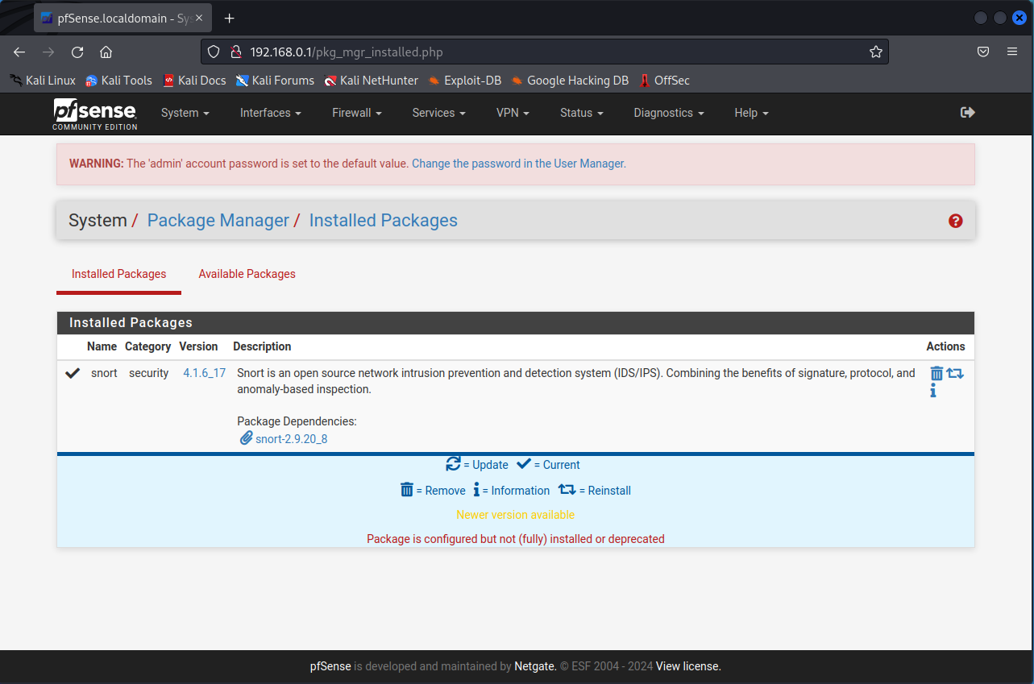
Installation of Snort
Navigated to the Package Manager tab under the System drop down
Searched for Snort on the available packages and properly installed the latest version

Slide 7
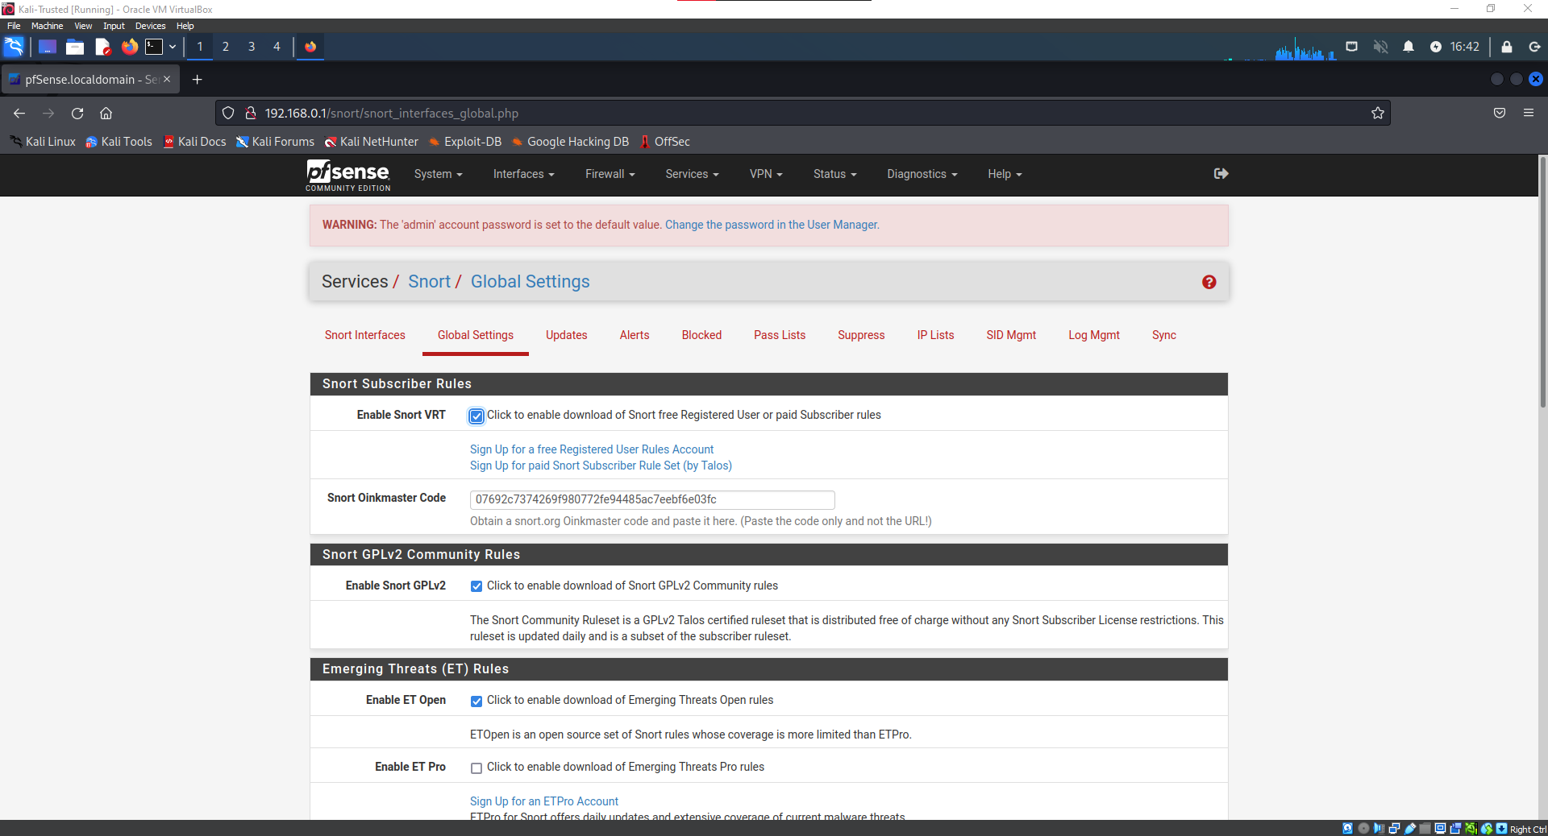
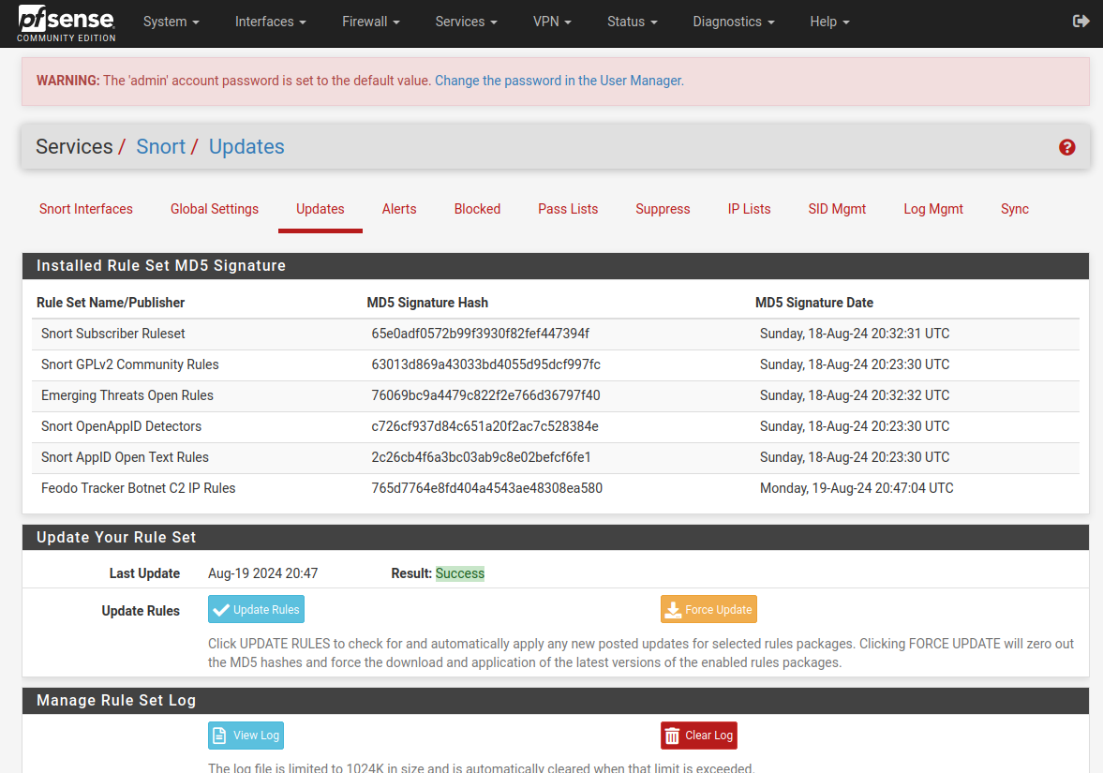
Installation and updating of Snort Rules
Navigated to the Snort tab under the Services drop down
Then went under the global settings and enabled Snort VRT and added my Snort Oinkmaster Code
Next I went to the updates tab and added the new rulesets obtained with Oinkmaster code

Slide 8
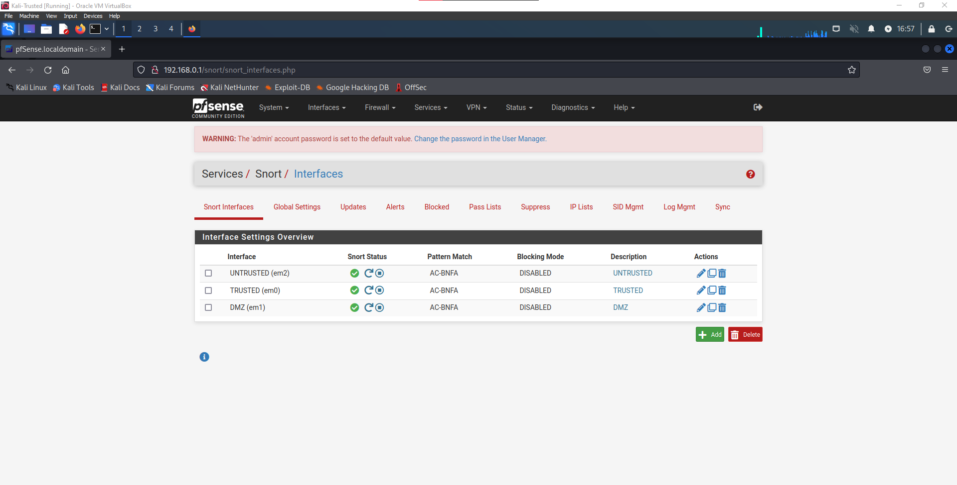
Adding of Interfaces
Navigated to the Snort tab under the Services drop down
Then under the Snort Interfaces tab I added the UNTRUSTED, TRUSTED, AND DMZ interfaces

Slide 9
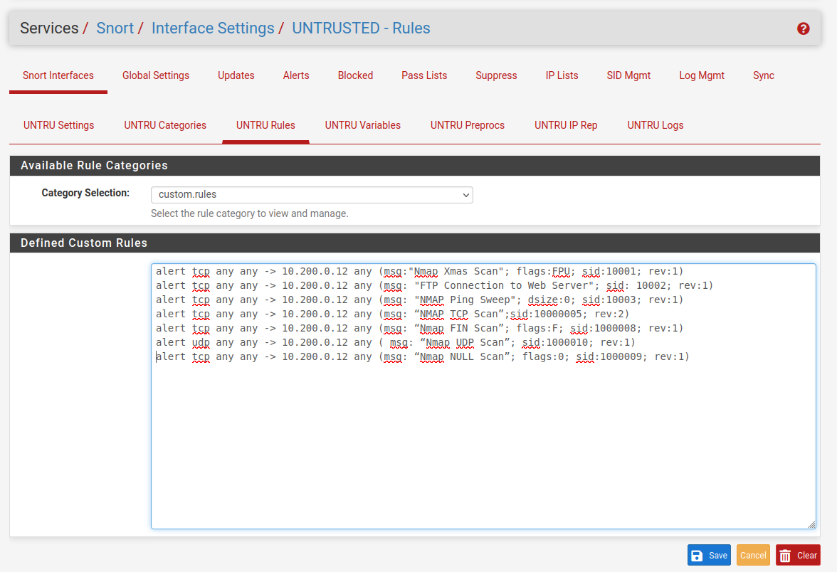
Adding of Custom Rules
Navigated to the Snort tab under the Services drop down
Then under the Snort Interfaces tab I went to edit the UNTRUSTED interface under the UNTRU Rules tab

Slide 10
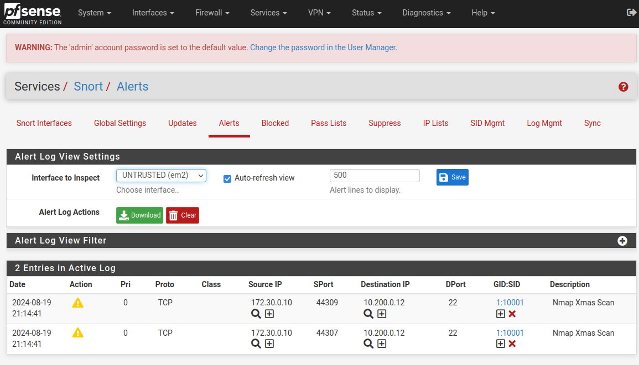
Alert of Xmas Scan
Xmas scan from kali untrusted to 10.200.0.12

Slide 11
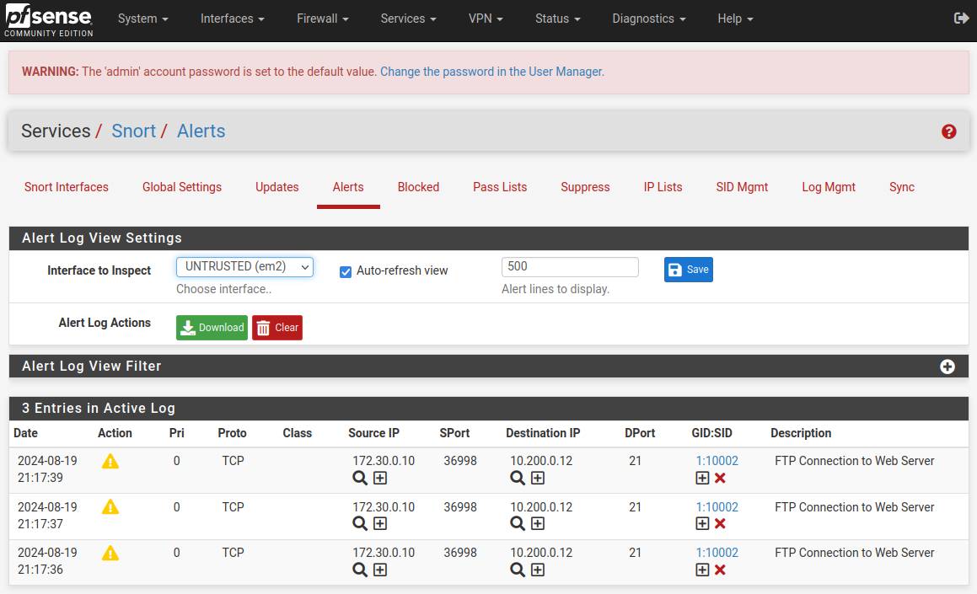
Alert of FTP
FTP from kali untrusted to 10.200.0.12

Slide 12
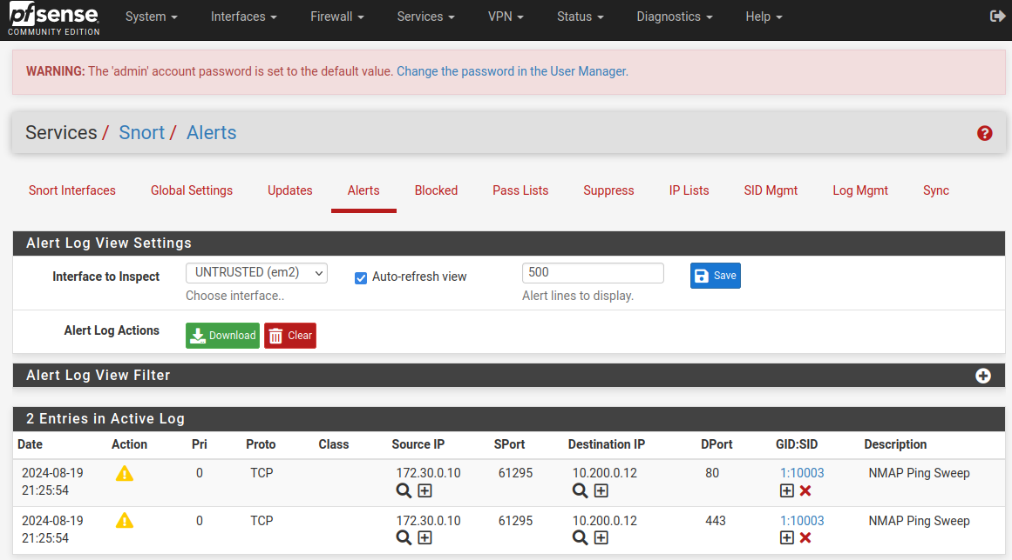
Alert of NMAP Ping Sweep
NMAP Ping Sweep from kali untrusted to 10.200.0.12

Slide 13
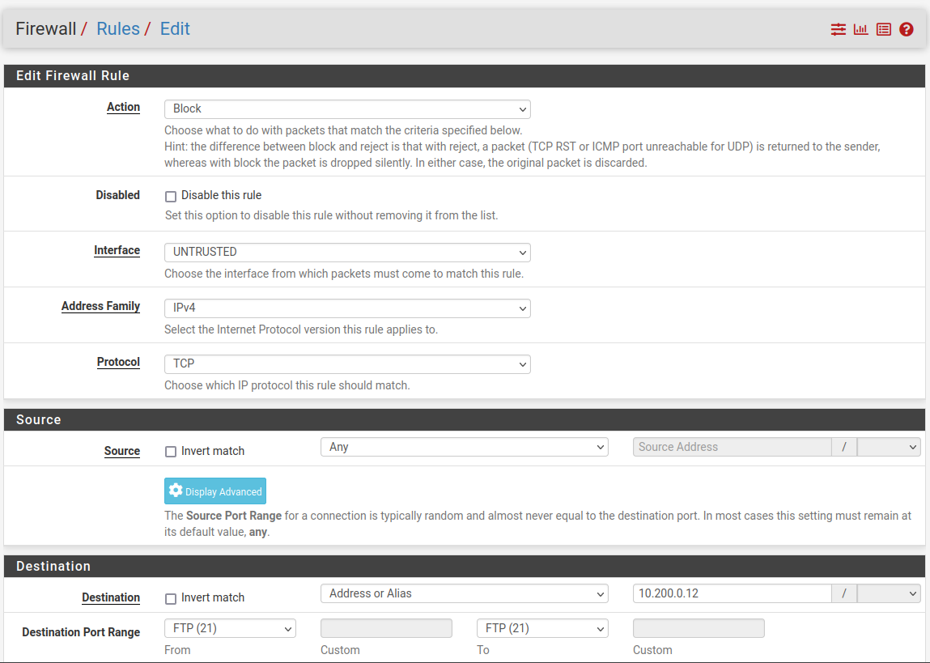
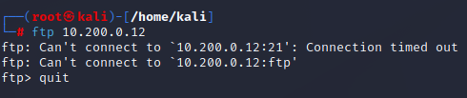
FTP Traffic Blocked
FTP from kali untrusted to 10.200.0.12 blocked by firewall settings

